Slide 1
MongoDB Architecture

Slide 2
Overview
Document oriented, not table/row oriented
Collection of binary JSON (BSON) documents
Schemaless
No relations or transactions native in database
Scalable and high-performance
Full index support
Written in C++
Servers for all major platforms
Drivers for all major development environments
Free and open-source, but also commercial support

Slide 3
MongoDB
GENERAL PURPOSE
DOCUMENT DATABASE
OPEN-SOURCE
5

Slide 4
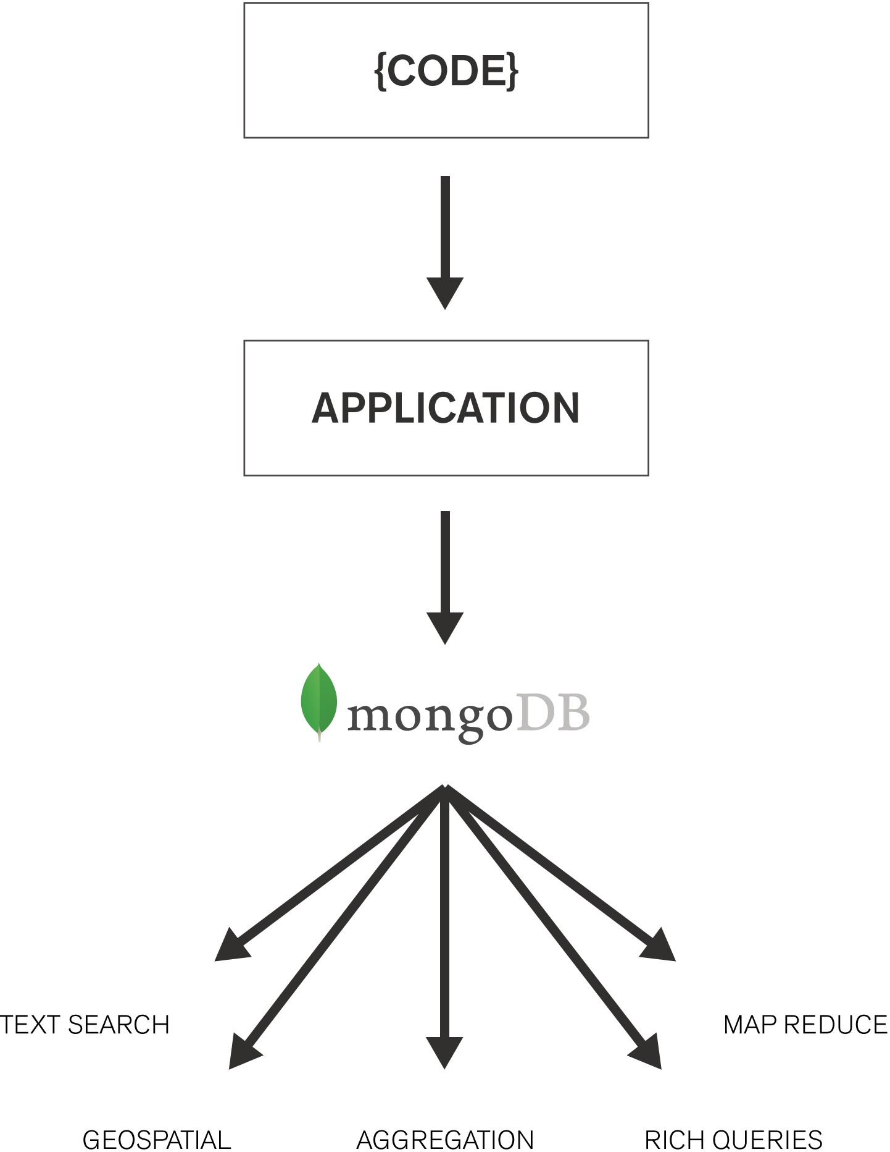
MongoDB is Fully Featured

Slide 5
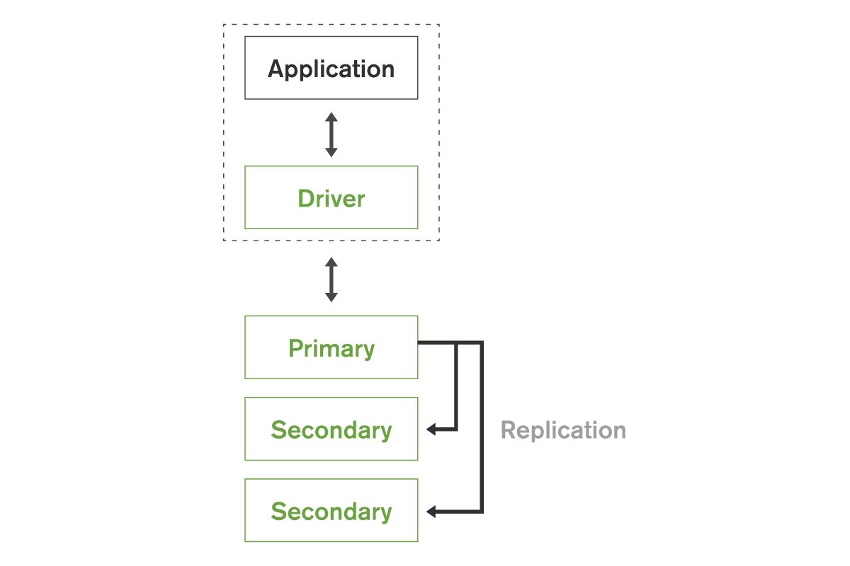
Replica Sets
Replica Set – 2 to 50 copies
Self-healing shard Data Center Aware
Addresses availability considerations:
High Availability Disaster Recovery
Maintenance
Workload Isolation: operational & analytics
5

Slide 6
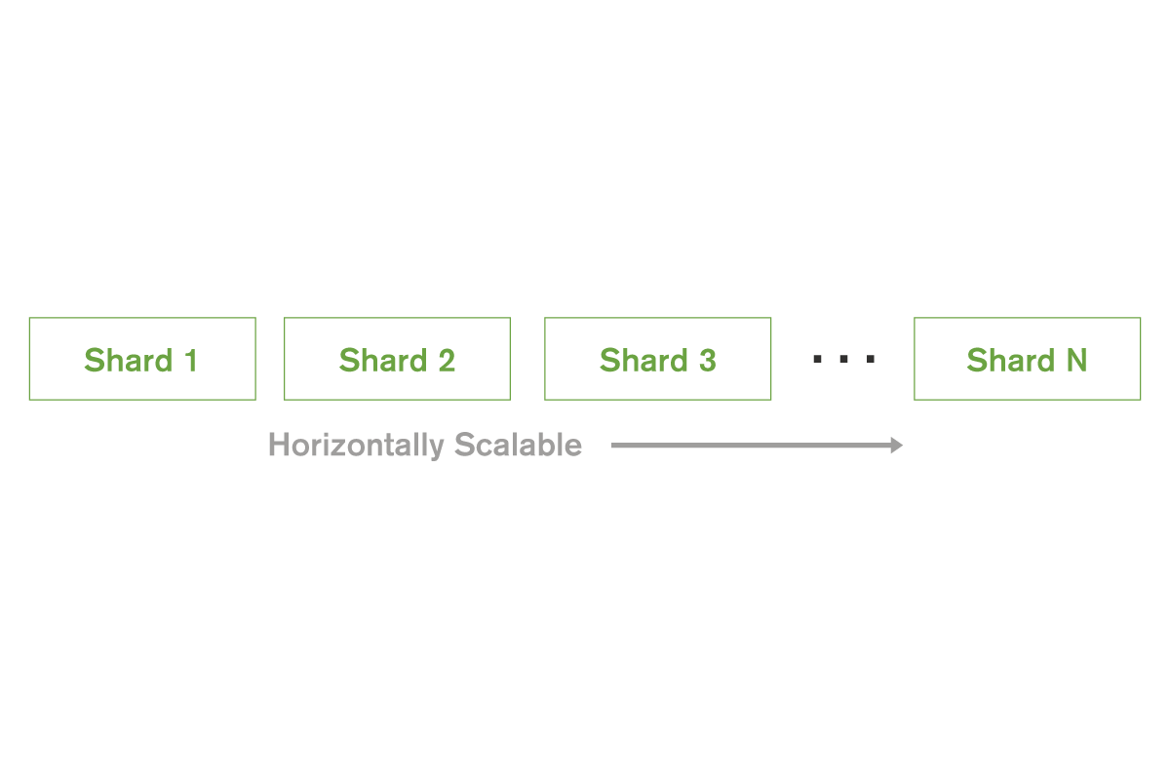
Horizontal Scalable
Three types: hash-based, range-based, location-aware
Increase or decrease capacity as you go Automatic balancing
6

Slide 7
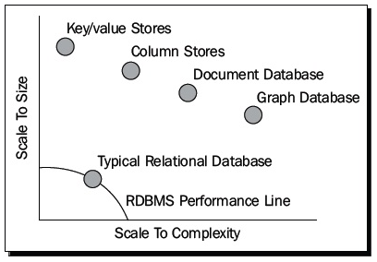
Use cases
High performance and scalable applications
Most web applications where you would previously use SQL
Do not use for:
Transaction-critical applications

Slide 8
MongoDB Architecture
Content Repo
IoT Sensor Backend
Ad Service
Customer Analytics
Archive
Security
MongoDB Query Language (MQL) + Native Drivers
Management
MongoDB Document Data Model
WT
MMAP V1
Encrypted
In-memory
3rd Party
Available 3.2
Beta
Your own?

Slide 9

MongoDB Architecture
Different workloads require different storage strategies
Exposed by a Storage Engine API
Provides more flexibility to your deployments
Storage Layer
WT
MMAP V1
Encrypted
In-memory
3rd Party
Officially supported
Beta
Your own?

Slide 10




MongoDB Architecture
BSON
Collections
Indexes
Databases
MongoDB Document Data Model
Data Model

Slide 11
BSON
Binary JSON
Binary encoded serialization of JSON-like documents
Like JSON, BSON supports the embedding of documents and arrays within other documents and arrays. BSON also contains extensions that allow representation of data types that are not part of the JSON spec. For example, BSON has a Date type and a BinData type.
The driver performs translation from the language’s “domain object” data representation to BSON, and back

Slide 12
Embedding documents
Nesting of objects and arrays inside a BSON document
For a “contains” type of relationship
Retrieve entire document with one call
{ _id: ObjectId(‘12345‘),
author: 'joe',
created : new Date('03/28/2009'),
title : 'Yet another blog post',
text : 'Here is the text...',
tags : [ 'example', 'joe' ],
comments : [ { author: 'jim', comment: 'I disagree' },
{ author: 'nancy', comment: 'Good post' }
]
}

Slide 13
Linking documents
“application-level relations”
Where embedding would cause duplication of data
{ _id: ObjectId(‘12345‘),
author: 'joe',
created : new Date('03/28/2009'),
title : 'Yet another blog post',
text : 'Here is the text...',
tags : [ 'example', 'joe‘ ]
}
{ author: 'jim',
post_id: ObjectId(‘12345‘),
comment: 'I disagree‘
}
{ author: 'nancy',
post_id: ObjectId(‘12345‘),
comment: 'Good post'
}

Slide 14
Querying
Queries return a cursor, which can be iterated to retrieve results
Query optimizer executes new plans in parallel
Queries are expressed as BSON documents which indicate a query pattern
db.users.find({'last_name': 'Smith'})
// retrieve ssn field for documents where last_name == 'Smith':
db.users.find({last_name: 'Smith'}, {'ssn': 1});
// retrieve all fields *except* the thumbnail field, for all documents:
db.users.find({}, {thumbnail:0});
// retrieve all users order by last_name:
db.users.find({}).sort({last_name: 1});
// skip and limit:
db.users.find().skip(20).limit(10);

Slide 15
Advanced querying
{ name: "Joe", address: { city: "San Francisco", state: "CA" } , likes: [ 'scuba', 'math', 'literature' ] }
// field in sub-document:
db.persons.find( { "address.state" : "CA" } )
// find in array:
db.persons.find( { likes : "math" } )
// regular expressions:
db.persons.find( { name : /acme.*corp/i } );
// javascript where clause:
db.persons.find("this.name != 'Joe'");
// check for existence of field:
db.persons.find( { address : { $exists : true } } );
Aggregate queries like group by, count, distinct; only available for single instances

Slide 16
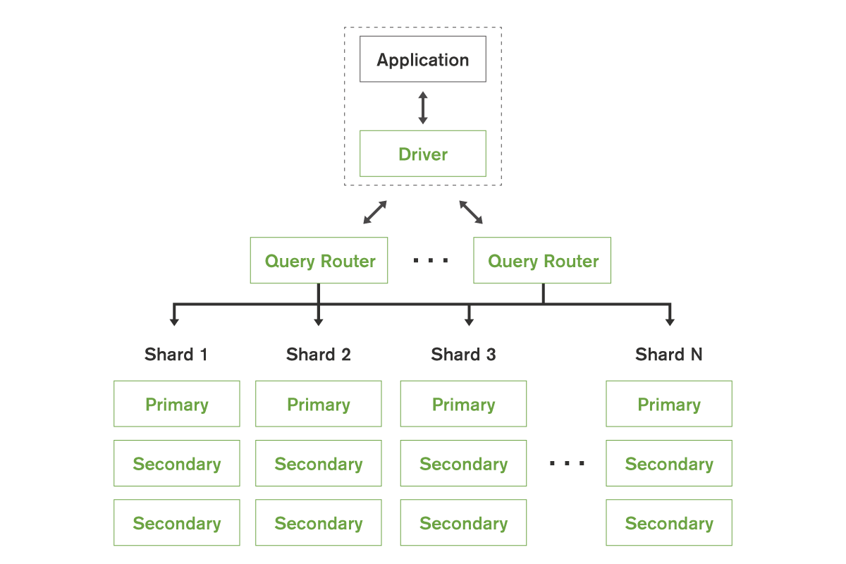

Distributed Database

Slide 17
Varying Access & Storage Requirements
High concurrency
High throughput
Cost effective storage
Low latency
Modern apps
Sensitive data
Real-time analytics

Slide 18
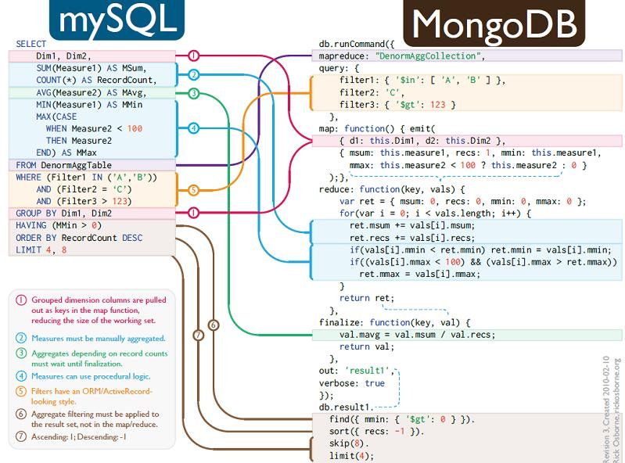
Map/Reduce

Slide 19
Data Model
Stores data in form of BSON (binary JavaScript Object Notation) documents
{
name: “travis”, salary: 30000,
designation: “Computer Scientist”, teams: [ “front-end”, “database” ]
}
Group of related documents with a shared common index is a collection

Slide 20
Terminology
RDBMS | MongoDB
Database | Database
Table | Collection
Index | Index
Row | Document
Join | Embedding & Linking
24

Slide 21
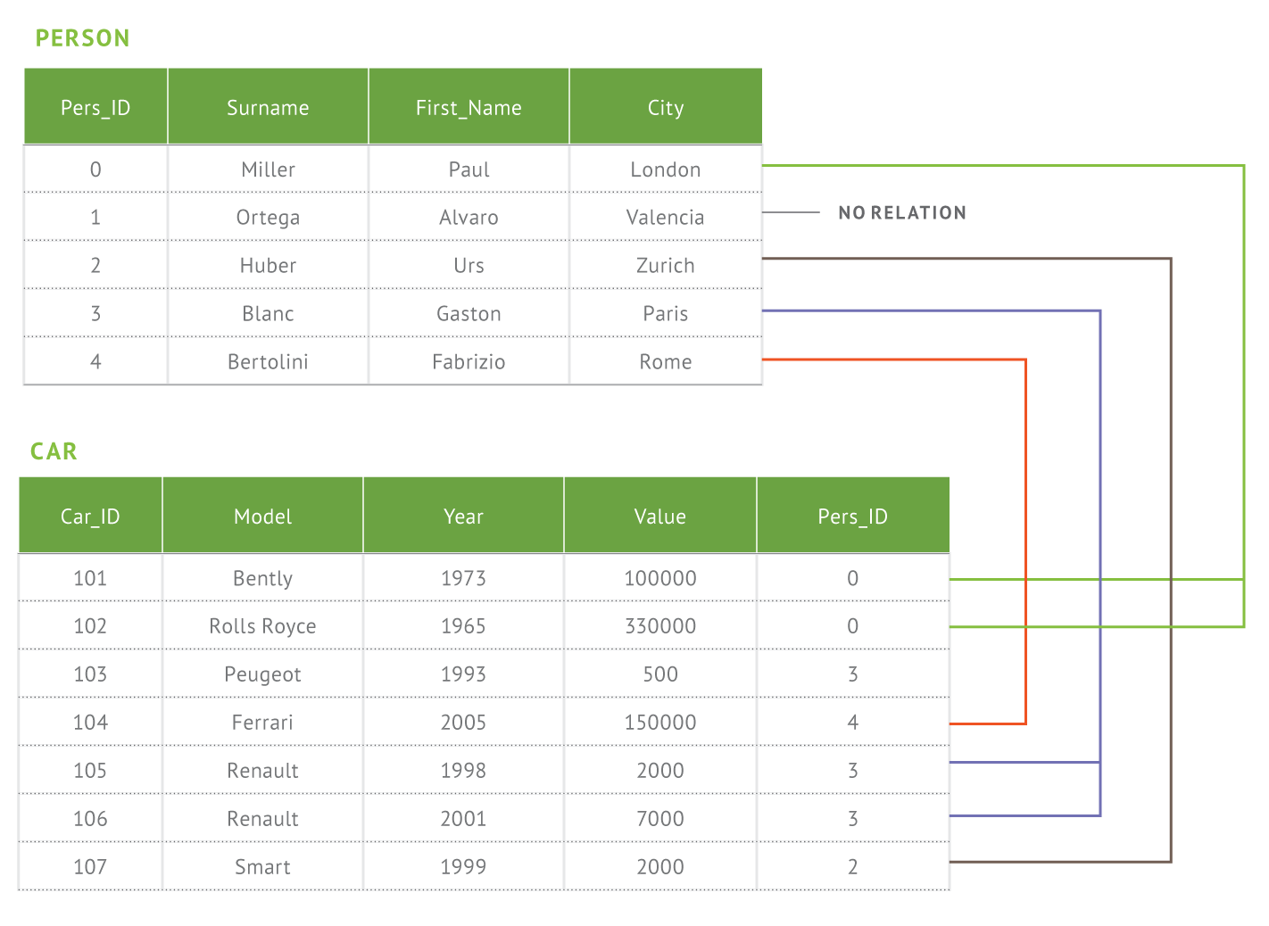
Document Data Model
Relational
MongoDB
{
first_name: ‘Paul’, surname: ‘Miller’, city: ‘London’,
location: [45.123,47.232],
cars: [
{ model: ‘Bentley’, year: 1973,
value: 100000, … },
{ model: ‘Rolls Royce’, year: 1965,
value: 330000, … }
]
}

Slide 22

Documents are Rich Data Structures
{
first_name: ‘Paul’,
surname: ‘Miller’, cell: 447557505611,
city: ‘London’,
location: [45.123,47.232],
Typed field values
String
Number
Fields
Fields can contain arrays
Profession: [‘banking’, ‘trader’],
cars: [
‘finance’,
{ model: ‘Bentley’, year: 1973,
Fields can contain an array of sub- documents
value: 100000, … },
{ model: ‘Rolls Royce’, year: 1965,
value: 330000, … }
]
26
}

Slide 23
Dynamic Schemas
{
{
{
policyNum: 123, type: auto, customerId: abc, payment: 899,
policyNum: 456, type: life, customerId: efg, payment: 240,
policyNum: 789, type: home, customerId: hij, payment: 650,
deductible: 500, make: Taurus, model: Ford,
VIN: 123ABC456,
policyValue: 125000,
start: jan, 1995
end: jan, 2015
}
deductible: 1000, floodCoverage: No, street: “10 Maple Lane”, city: “Springfield”,
state: “Maryland”
}
}

Slide 24
Query
Query all employee names with salary greater than 18000 sorted in ascending order
db.users.find({salary:{$gt:18000}, {name:1}}).sort({salary:1})
Collection Condition Projection Modifier
{salary:25000, …}
{salary:10000, …}
{salary:20000, …}
{salary:2000, …}
{salary:30000, …}
{salary:21000, …}
{salary:5000, …}
{salary:50000, …}
{salary:25000, …} |  |  | {salary:20000, …}
{salary:20000, …} |  |  | {salary:21000, …}
{salary:30000, …} |  |  | {salary:25000, …}
{salary:21000, …} |  |  | {salary:30000, …}
{salary:50000, …} |  |  | {salary:50000, …}

Slide 25

Query Engine
Your Super Cool App
Query Engine
Command Parser / Validator
Logging / Profiling
Authorization
DML Write Operation Read Operation
Query Planner

Slide 26

CRUD Commands
find command
getMore command
killCursors command
insert command
update command
delete command
other commands
35

Slide 27
Insert
Insert a row entry for new employee Sally
db.users.insert({
name: “sally”, salary: 15000, designation: “MTS”,
teams: [ “cluster-management” ]
})

Slide 28
Update
All employees with salary greater than 18000 get a designation of Executive
db.users.update(
{salary:{$gt:18000}},
{$set: {designation: “Manager”}},
{multi: true}
)
Update Criteria Update Action Update Option
Multi option allows multiple document update

Slide 29
Delete
Remove all employees who earn less than 10000
db.users.remove(
{salary:{$lt:10000}},
)
Remove Criteria
Can accept a flag to limit the number of document removal

Slide 30
Indexes
Unique index on primary key (_id field)
Create index from application code (ensureIndex)
Index on embedded documents and fields
Index on array fields (multikey index)
Unique and sparse index
Geospatial index
TTL index
No native full text indexing

Slide 31
Indexes
// Index nested documents
db.customers.ensureIndex( “policies.agent”:1 )
db.customers.find({‘policies.agent’:’Fred’})
// geospatial index
db.customers.ensureIndex( “property.location”: “2d” )
db.customers.find( “property.location” : { $near : [22,42] } )
// text index
db.customers.ensureIndex( “policies.notes”: “text” )

Slide 32
Partial Indexes
https://docs.mongodb.org/manual/release-notes/3.2/#partial-indexes

Slide 33
Replication
A replica set is a cluster of mongod instances
2-12 instances; one is primary
Writes are directed to primary
Secondary instances replicate from primary asynchronously
Automated failover; when primary fails a secondary will be elected the new primary

Slide 34
Auto-sharding
Partitions data across shards
Any BSON document resides on only one shard
Increases write capacity and total data size
Data automatically distributed
Sharding transparent to application layer
Partitioning based on client-defined shard key
Good shard keys are highly distributed in value and write operations
Sharding requires config servers (minimal 3) to maintain metadata

